Slide 1
Current Amare EDGE+ Formula | New Amare EDGE+ Formula
Palm Fruit – supports BDNF and Neuron Health* | Nutricog® - Like Palm Fruit, Nutricog supports BDNF for neuron health, and like Lychee Fruit, it supports mental endurance. But it goes even further—supporting multiple areas of cognitive function, including short and long-term memory, learning rate, focus and attention—all in one powerful ingredient.
Lychee Fruit – supports mental endurance*
Mango Leaf – supports motivation and mental flow* | Mango Leaf – supports motivation and mental flow*
Lion’s Mane – supports neuron health and memory* | Lion’s Mane – supports neuron health and memory*
Citicoline - A precursor to neurotransmitters.* | Citicoline - A precursor to neurotransmitters.*
Current Amare EDGE+ Formula | New Amare EDGE+ Formula
Palm Fruit – supports BDNF and Neuron Health* | Nutricog® - Like Palm Fruit, Nutricog supports BDNF for neuron health, and like Lychee Fruit, it supports mental endurance. But it goes even further—supporting multiple areas of cognitive function, including short and long-term memory, learning rate, focus and attention—all in one powerful ingredient.
Lychee Fruit – supports mental endurance*
Mango Leaf – supports motivation and mental flow* | Mango Leaf – supports motivation and mental flow*
Lion’s Mane – supports neuron health and memory* | Lion’s Mane – supports neuron health and memory*
Citicoline - A precursor to neurotransmitters.* | Citicoline - A precursor to neurotransmitters.*
NEW Advanced Formula
We’ve elevated the formula by removing Lychee Fruit and Palm Fruit and introducing Nutricog®.
Kids Happy Juice has been upgraded with Nutricog®, the same powerful ingredient featured in the updated adult EDGE+ formula. It delivers half the adult dose, reflecting current research on suitable ingredient levels to support children’s unique needs. We have mirrored the same Mixed Berry Flavor used in original formula, however you may experience a slight taste difference with the addition of Nutricog® in the new, advanced formula.
CURRENT
NEW
Kids Happy Juice Formula |  | Kids Happy Juice Formula
Neuro-nutrients A plant-based blend of Mango Leaf, Lychee Fruit, Palm Fruit and Suntheanine | Neuro-nutrients A plant-based blend of neuro-nutrient ingredients including Mango Leaf, Suntheanine® and Nutricog® - a patented combination of Boswellia and Haritaki.
Probiotics Our proprietary MW3® Probiotic Blend contains 3 strains of probiotics including Lactobacillus helveticus R0052, Lactobacillus Rhamnosus R0011 and Bifidobacterium longum R0175. | Probiotics Our proprietary MW3® Probiotic Blend contains 3 strains of probiotics including Lactobacillus helveticus R0052, Lactobacillus Rhamnosus R0011 and Bifidobacterium longum R0175.
Prebiotics A blend of 3 prebiotic fibers to nourish the gut* | Prebiotics A blend of 3 prebiotic fibers to nourish the gut.*
*These statements have not been evaluated by the Food & Drug Administration. This product is not intended to diagnose, treat, cure or prevent any disease.

Slide 2
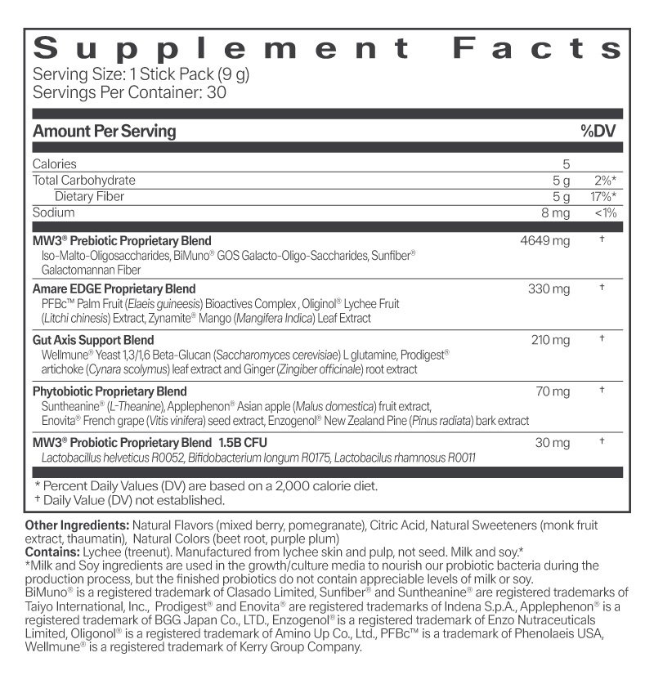
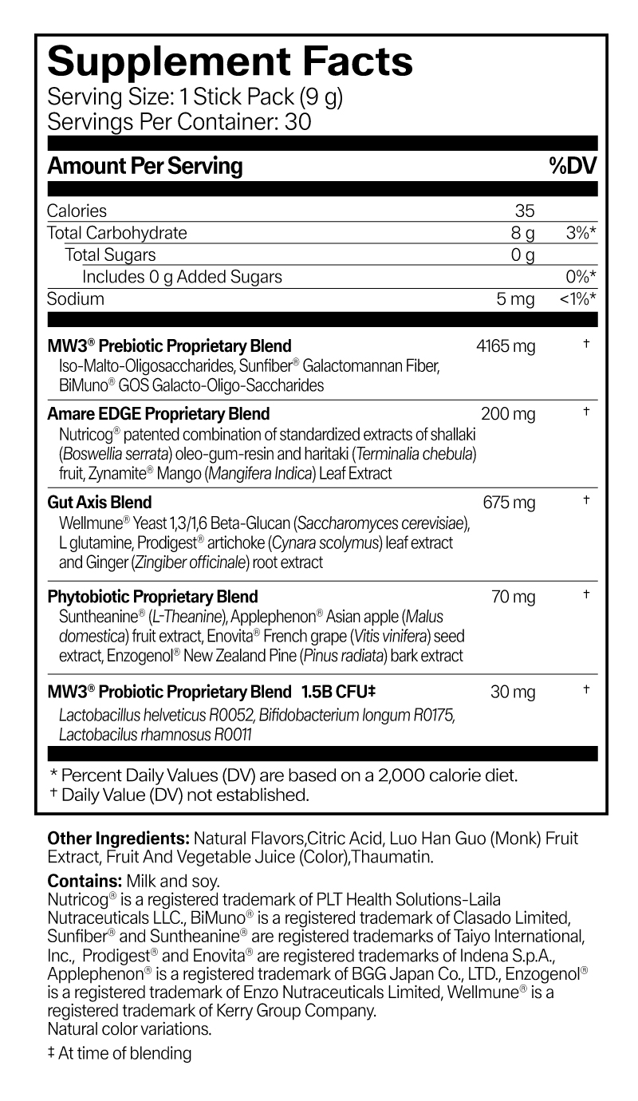
Label Comparison
CURRENT
Kids Happy Juice Formula |  | Kids Happy Juice Formula
NEW

Slide 3
Supplement Facts Panel Changes
You may notice a few updates to the Kids Happy Juice Supplement Facts Panel, and we want to be fully transparent about what changed and why:
Slight increase in calories and carbohydrates
These values increased slightly due to the addition of Nutricog® and a higher amount of L-Glutamine in our Gut-Axis Support Blend. We also implemented more advanced testing methods, which provide even more precise measurements.
Fiber is no longer listed
Iso-malto-oligosaccharides were previously counted as dietary fiber. While this ingredient is still in the formula, updated FDA regulations no longer allow it to be classified or claimed as fiber. As a result, it has been removed from the fiber line on the panel.
Amare EDGE proprietary blend update
The blend amount changed from 330 mg to 200 mg due to the removal of Palm Fruit and Lychee Fruit and the addition of Nutricog®. Nutricog® is a more concentrated ingredient that delivers its benefits at a lower effective dose.
Gut-Axis Support Blend update
The blend amount increased from 210 mg to 675 mg to include a higher level of L-Glutamine. This increase helps further support gut health and also improves solubility of the product, making mixing even easier.

