Slide 1
Understanding TikTok:
Content Types and Compliance

Slide 2
Agenda
Part 1: How TikTok Works
Part 2: The Seven Content Formats
Part 3: How to Post a Shoppable Video
Part 4: Compliance on TikTok

Slide 3
How TikTok Works

Slide 4
What Makes TikTok Different
Reach is NOT limited to your followers, content is served based on watch behavior
The For You Page (FYP) is the main feed, most views come from there, not followers
Watch time and completion rate are the most important algorithm signals
Authenticity consistently outperforms polished advertising on this platform
TikTok Shop is built in, buyers never leave the app to purchase
Notes:
Eligibility Requirements
Must be at least 18 years old
Must be based in the United States
Must have a minimum of 1,000 followers on TikTok
Must not have had e-commerce permissions previously revoked
Must pass TikTok's identity verification process (covered in Part 5)
If You Are Under 1,000 Followers
You cannot apply for Affiliate Creator status yet. Focus on building your audience first.
Post consistently, engage with your niche, and come back to this step once you hit 1,000 followers.
You can still watch and prepare all other videos while you build your following.

Slide 5
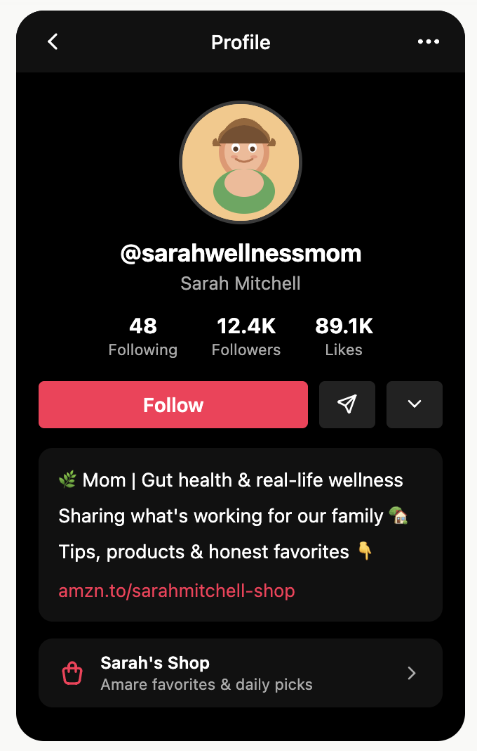
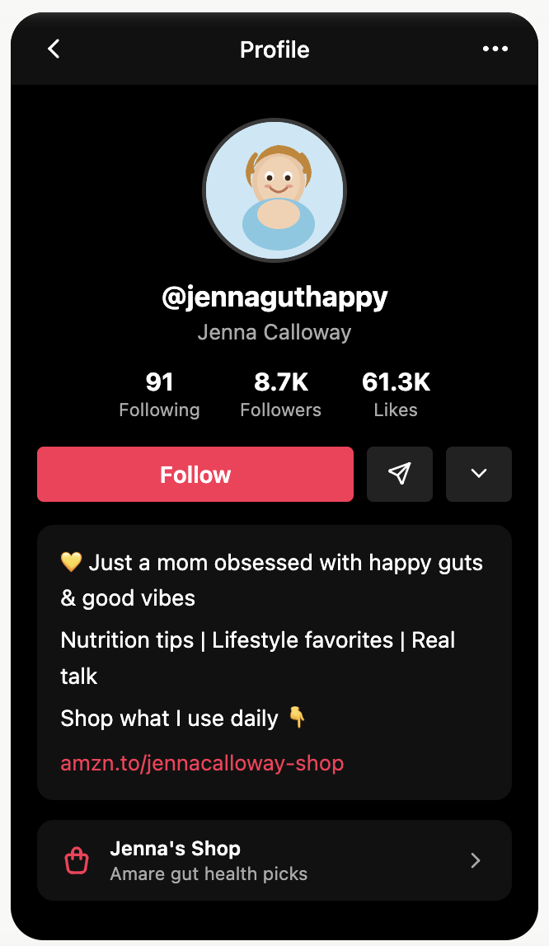

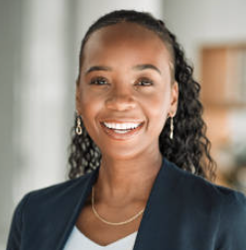

Optimize Your Profile
Profile Photo: Clear, well-lit photo of your face. Natural light, warm smile. Your photo should match how you look on camera.
Bio: Answer who are you, what do you share, and why should someone follow you? ​No income claims or health results in your bio.
Link: Point to your Amare TikTok Shop Product Showcase once set up.
Notes:
Why Business Account?
Unlocks TikTok Analytics so you can track what content is working
Gives you access to Creator Tools and TikTok Shop for Creator
Keeps your professional content separate from personal use
Required to access TikTok Shop affiliate features
Select Health and Wellness as your category -- this helps TikTok understand your niche from day one.

Slide 6
The Seven Content Formats
Notes:
Screens may change

Slide 7
Format Overview
Primary Formats
Supporting Formats
Short-Form Video (In-Feed): primary format
LIVE Video: highest-conversion format
Product Showcase Tab: passive income infrastructure
Duet: react alongside another creator
Stitch: clip + respond to trending content
Photo Carousel: swipeable educational posts
Text Posts: low-effort presence on no-filming days
Notes:
Eligibility Requirements
Must be at least 18 years old
Must be based in the United States
Must have a minimum of 1,000 followers on TikTok
Must not have had e-commerce permissions previously revoked
Must pass TikTok's identity verification process (covered in Part 5)
If You Are Under 1,000 Followers
You cannot apply for Affiliate Creator status yet. Focus on building your audience first.
Post consistently, engage with your niche, and come back to this step once you hit 1,000 followers.
You can still watch and prepare all other videos while you build your following.

Slide 8
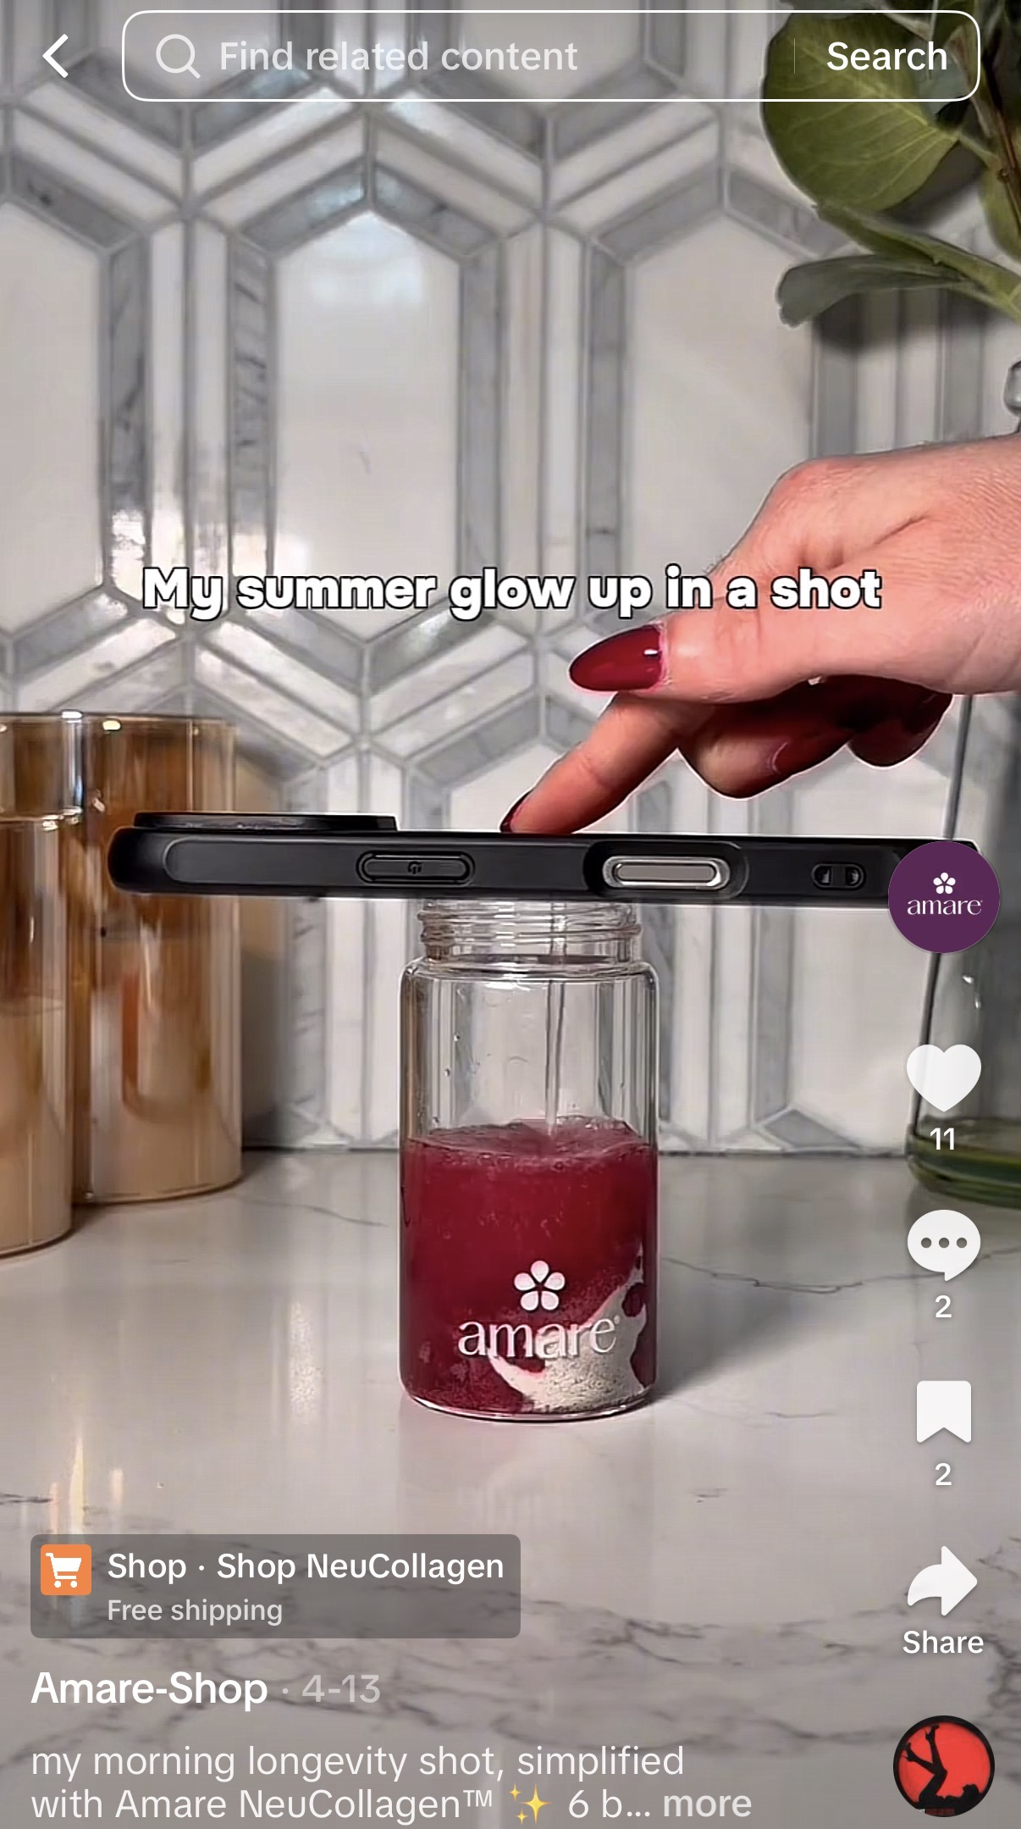
1. Short-Form Video (In-Feed)
Vertical video up to 10 minutes; recommended length 30–90 seconds
Served to both followers AND new audiences via the FYP
Add an Amare product link before posting to make it shoppable (orange shopping bag icon)
Counts toward your 5-video weekly shoppable limit in the Pilot Program
Best for: product education, personal stories, routines, tutorials, hook-driven content

Slide 9
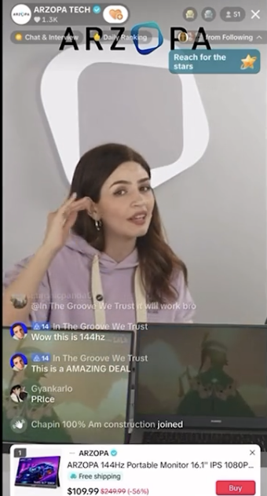
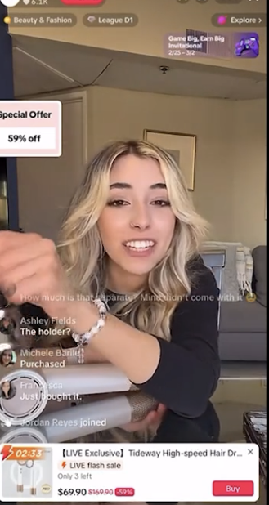
2. LIVE Video
Real-time broadcast with products pinned to the bottom of screen
Requires 1,000 followers to unlock
Limited to 3 shoppable LIVEs per week during the Pilot Program
Viewers can tap and purchase without leaving your LIVE
Best for: Q&A, product demos, community building, time-sensitive offers

Slide 10
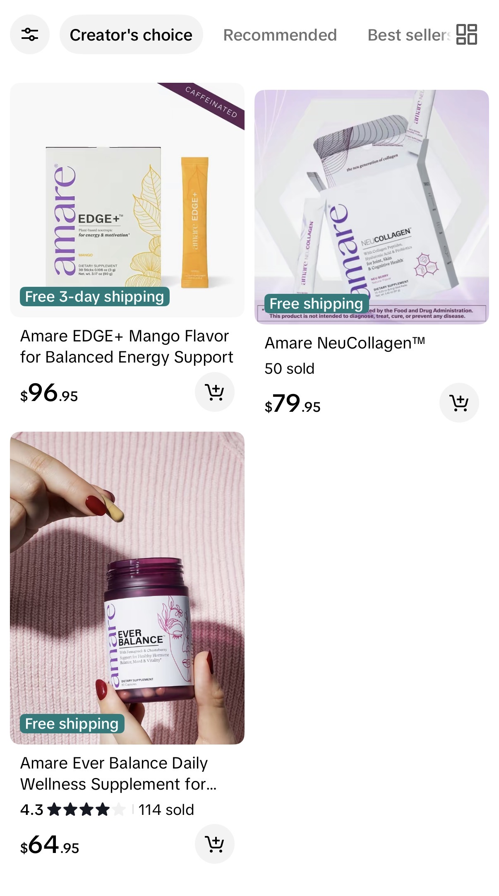
3. Product Showcase Tab
A curated shopping page on your profile, visitors can browse and buy without watching a video
Does NOT count toward weekly shoppable posting limits
Organize products by routine or category, e.g. 'My Daily Stack', 'For Better Energy', 'Sleep Support’
Best for: passive discovery and giving new profile visitors an easy path to purchase

Slide 11
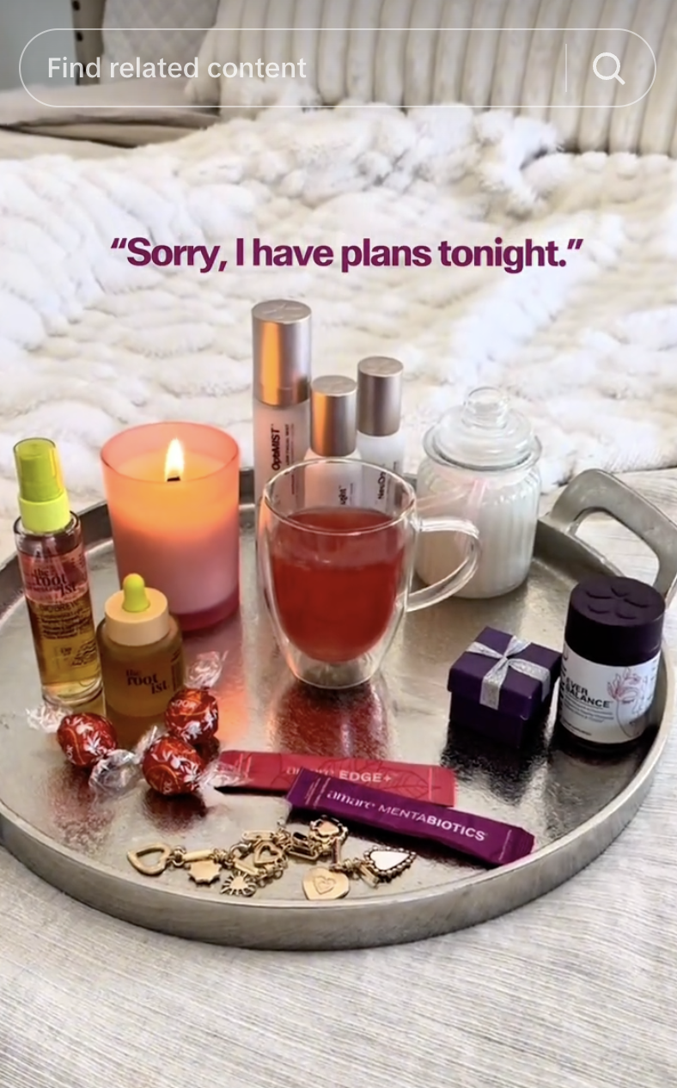
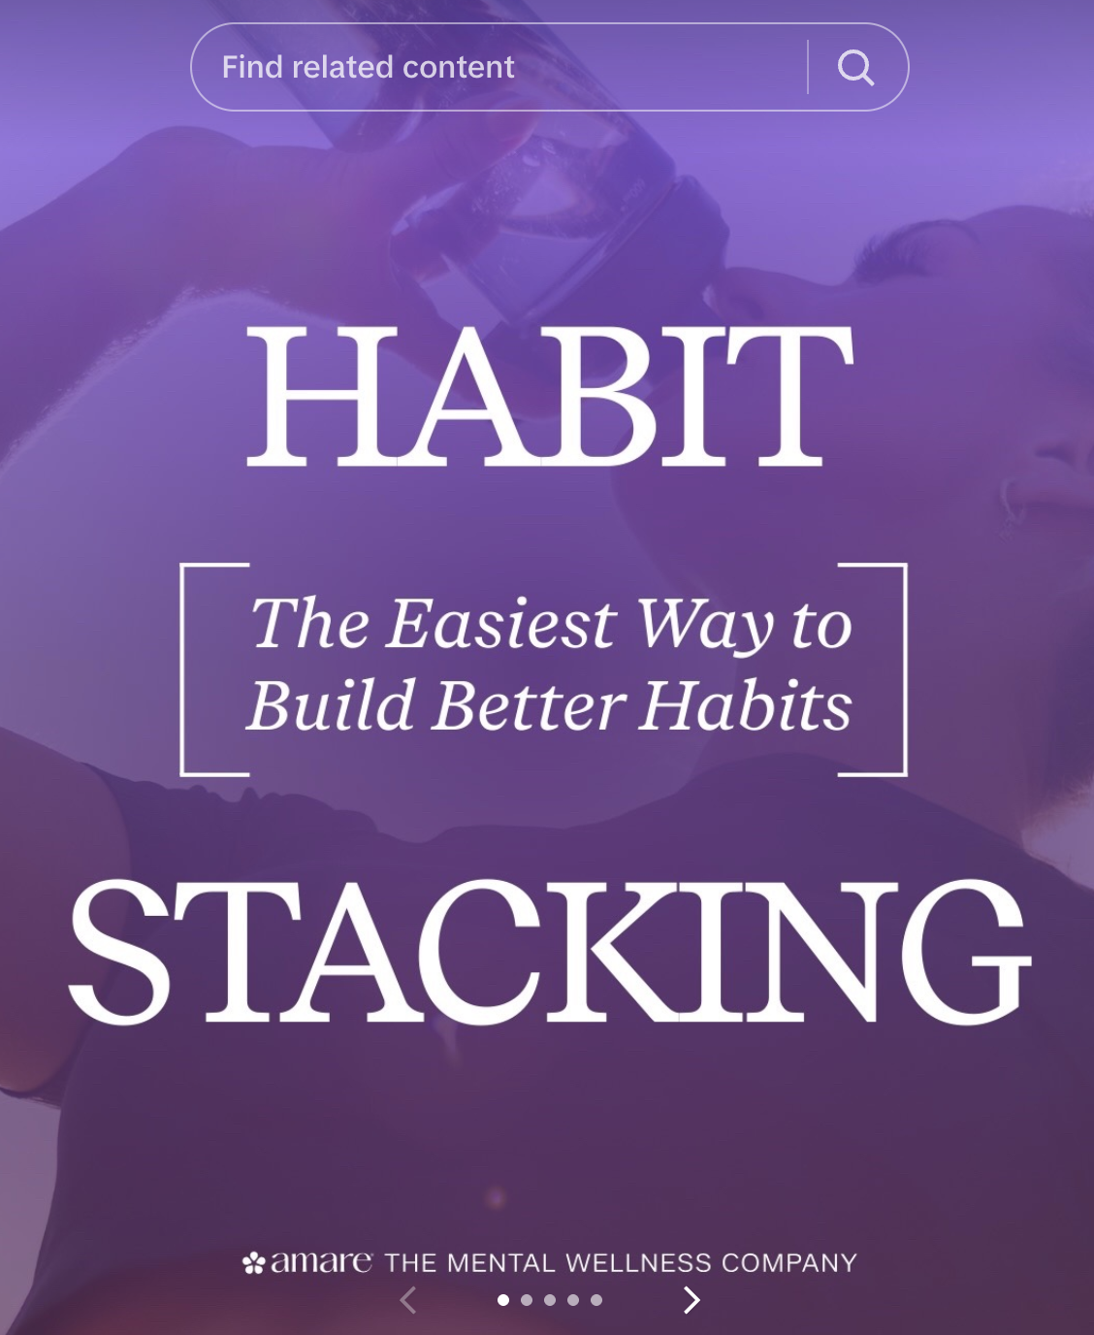
4–7. Supporting Formats
Duet: split-screen alongside another creator's video; react to wellness content or trending health conversations
Stitch: clip up to 5 seconds from another creator, then continue with your response to trending questions
Photo Carousel: swipeable still images; great for ingredient breakdowns, step-by-step guides, and list content
Text Posts: written content in the FYP; no product link available; good for wellness takes and conversation starters

Slide 12
How to Post a Shoppable Video
Notes:
Screens may change

Slide 13
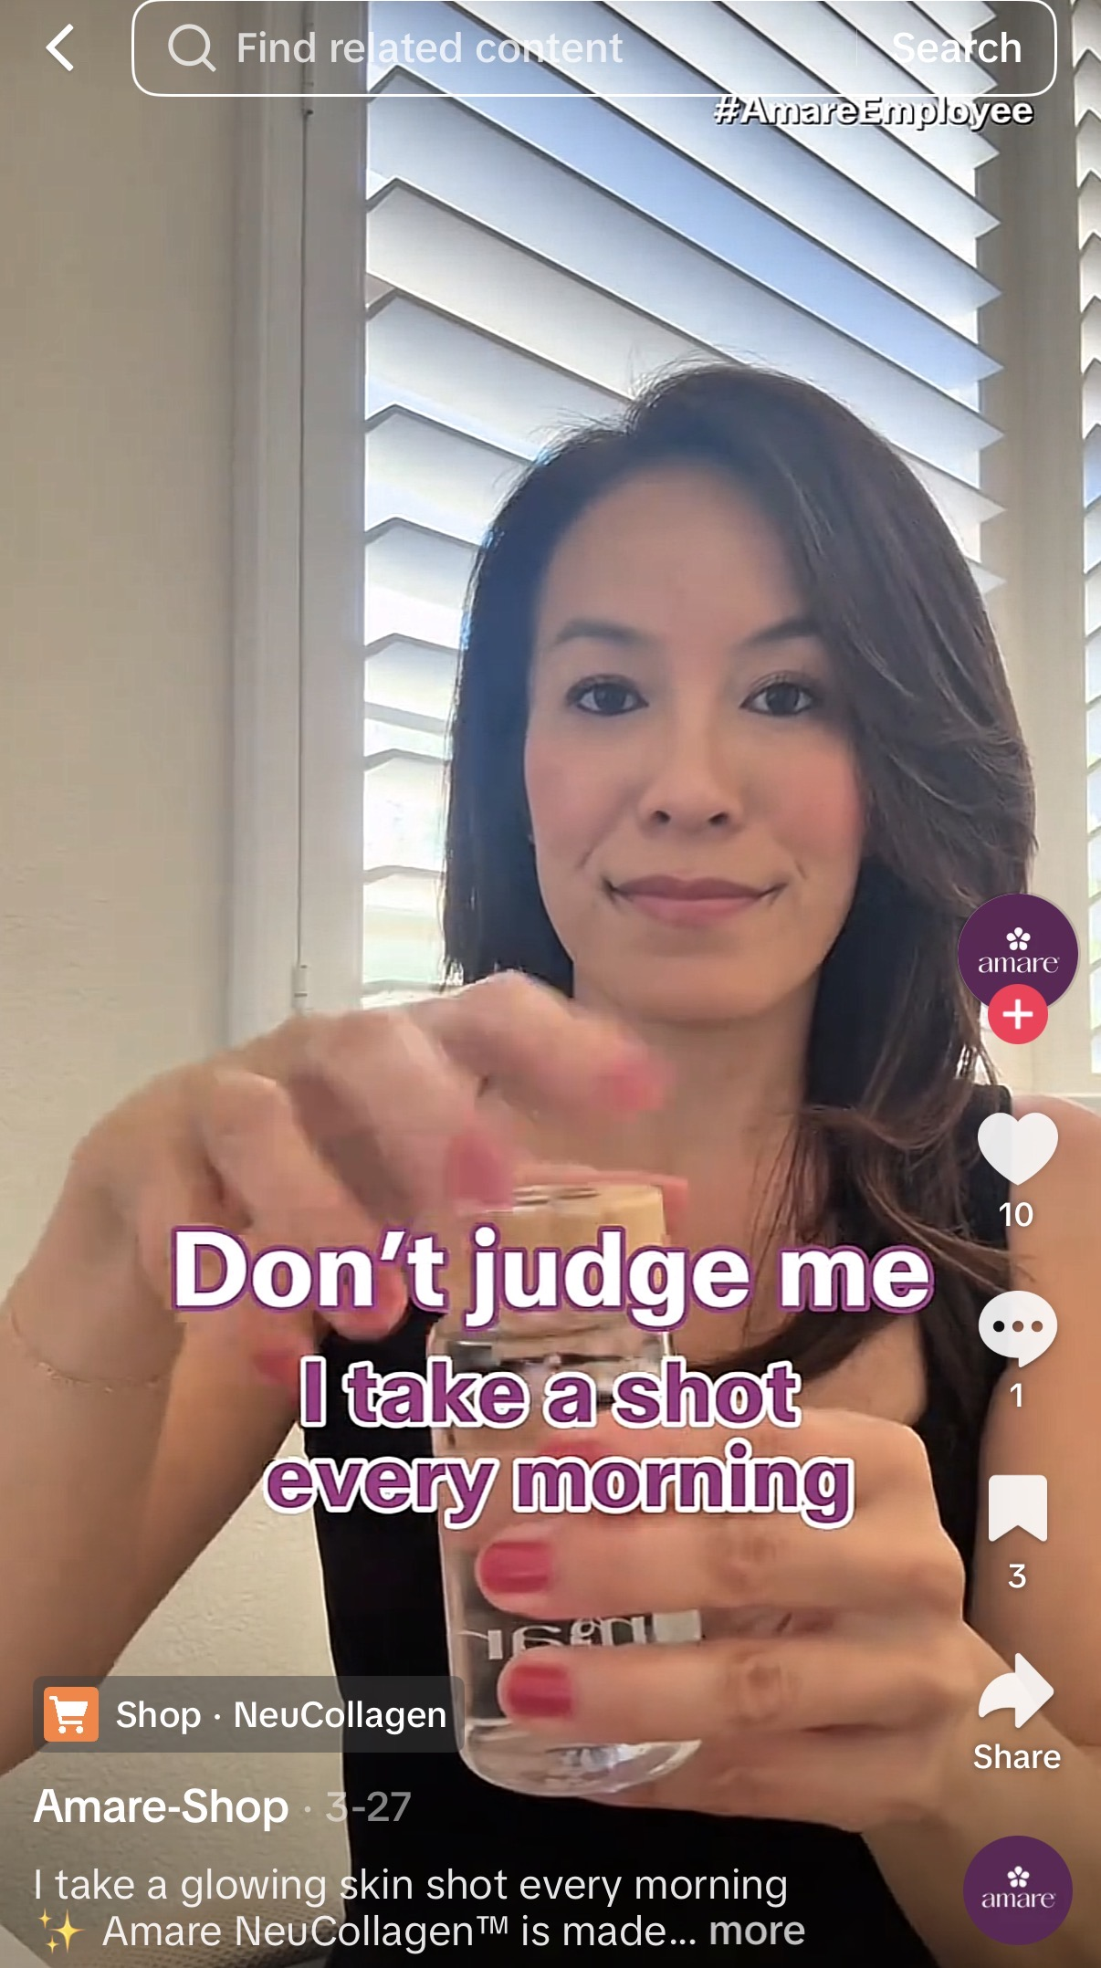
Adding a Product Link to an In-Feed Video
Film or select your video in the TikTok app as normal
On the Post screen, tap Add Link or Product Link
Search for the Amare product you are featuring and select it
Confirm the orange shopping bag icon appears on your video
Write your caption (include FTC disclosure #AmareBrandPartner)
Add 3–5 relevant hashtags
Tap Post

Slide 14
1
Product Link
Is your product link added and showing the correct Amare product?
Disclosure
Does your caption include your affiliate disclosure (#AmareBrandPartner)?
Call to Action
Does your video include a spoken call-to-action telling viewers to tap the link?
Before You Post: 3 Point Check
2
3

Slide 15
Adding Products to a LIVE Session
Before going LIVE: TikTok > Live > Product Showcase
Add the Amare products you plan to feature during the stream
Once live, tap the shopping bag icon on screen to pin a specific product
Viewers can tap the product card at any point to view and purchase without leaving your LIVE

Slide 16
Compliance on TikTok
Notes:
Screens may change

Slide 17
Complete Amare's Compliance Training
Amare has a dedicated compliance training covering FTC disclosures, income claims, and health claim guidelines in full in the HUB
Complete that training before posting any content with Amare products

Slide 18
Health and Medical Claims
TikTok prohibits claims that a product treats, cures, prevents, or mitigates any disease or medical condition
Applies to spoken content in videos and LIVEs, captions, and text overlays
Always use Amare's approved product language, do not improvise health benefit claims
Don't say: 'This product cured my anxiety' or 'This fixed my gut inflammation'
Do say: 'I've noticed I feel calmer and more focused since I started using this'

Slide 19
Income and Earnings Claims
Do not make specific income claims, projections, or suggestions that financial success is typical or guaranteed
Don't say: 'I made $5,000 last month with TikTok Shop' or 'Anyone can replace their income doing this'
Do say: 'I've been building something I'm proud of' or 'It's been a great fit for my lifestyle'

Slide 20
MLM and Recruitment Language
TikTok explicitly bans content promoting multi-level marketing, pyramid schemes, or recruitment under its Fraud and Scams policy
Content that focuses on recruiting or sounds like 'join my team' will be flagged and may result in removal or account suspension
Promoting Amare products is allowed. Recruiting people into the Amare business on TikTok is not.
Don't say: 'Join my team', 'Be your own boss', 'DM me about the business opportunity', or 'Passive income'

Slide 21
Weight Loss Content & FTC Disclosure
Weight Loss: TikTok restricts content promoting dangerous or unproven weight loss methods
Before/after body transformation content may be flagged or suppressed even if not removed
Weight loss content is restricted from reaching users under 18, the algorithm enforces this automatically
FTC Disclosure: As a paid affiliate, you are legally required to disclose your relationship with Amare on every promotional post. Use #AmareBrandPartner
TikTok also has a built-in Branded Content toggle

Slide 22
What Happens If You Receive a Violation
TikTok notifies you via TikTok Inbox > System notifications when content is removed or flagged
Violations accumulate in your Creator Health Rating, stay above 176 points to graduate from the Pilot Program
Repeated violations can result in e-commerce permissions being suspended or permanently revoked
To appeal: TikTok app > Inbox > System > find the violation notice > Appeal
TikTok may allow you to take a quiz depending on the violation you receive. If you get 100% on the quiz they will add 5 points back to your CHR.

Slide 23
The Simplest Rule
Before you post, ask yourself:
Does this video promote a product or promote a business opportunity? Products only.
Would a doctor, lawyer, or compliance officer be uncomfortable with any claim I'm making? If yes, reword it or leave it out.
When in doubt, contact your Amare compliance team before posting.

Slide 24
Next Steps
Optimize your profile and build your following
Review compliance details in the Hub
Post Shoppable videos and LIVES to start sharing Amare products
Stay tuned for more training videos!

