Slide 1
Getting Started on TikTok Shop

Slide 2
Agenda
Why TikTok Shop
Setting Up Your Account
Becoming an Affiliate Creator
The Creator Pilot Program

Slide 3
Why TikTok Shop?

Slide 4
1
70M+ U.S. Shoppers
TikTok Shop is the fastest-growing social commerce platform in the U.S. health and wellness is the top-selling category.
Shopping has Moved to the Feed
Your customers are already on TikTok, discovering products, watching reviews, and buying without ever leaving the app.
Same Selling, Bigger Audience
TikTok doesn’t limit your reach to your followers. Your content can reach anyone interested in wellness, from your very first post.
The Opportunity is Already There
2
3
Notes:
70M+ U.S. shoppers are already on TikTok Shop. Health and wellness is the fastest-growing product category.
3 in 4 users are more likely to buy brands seen on TikTok
This is the same trust-based, story-driven selling you already do as an Amare brand partner. TikTok puts it in front of a much bigger audience.

Slide 5
Account Setup
Notes:
Screens may change

Slide 6
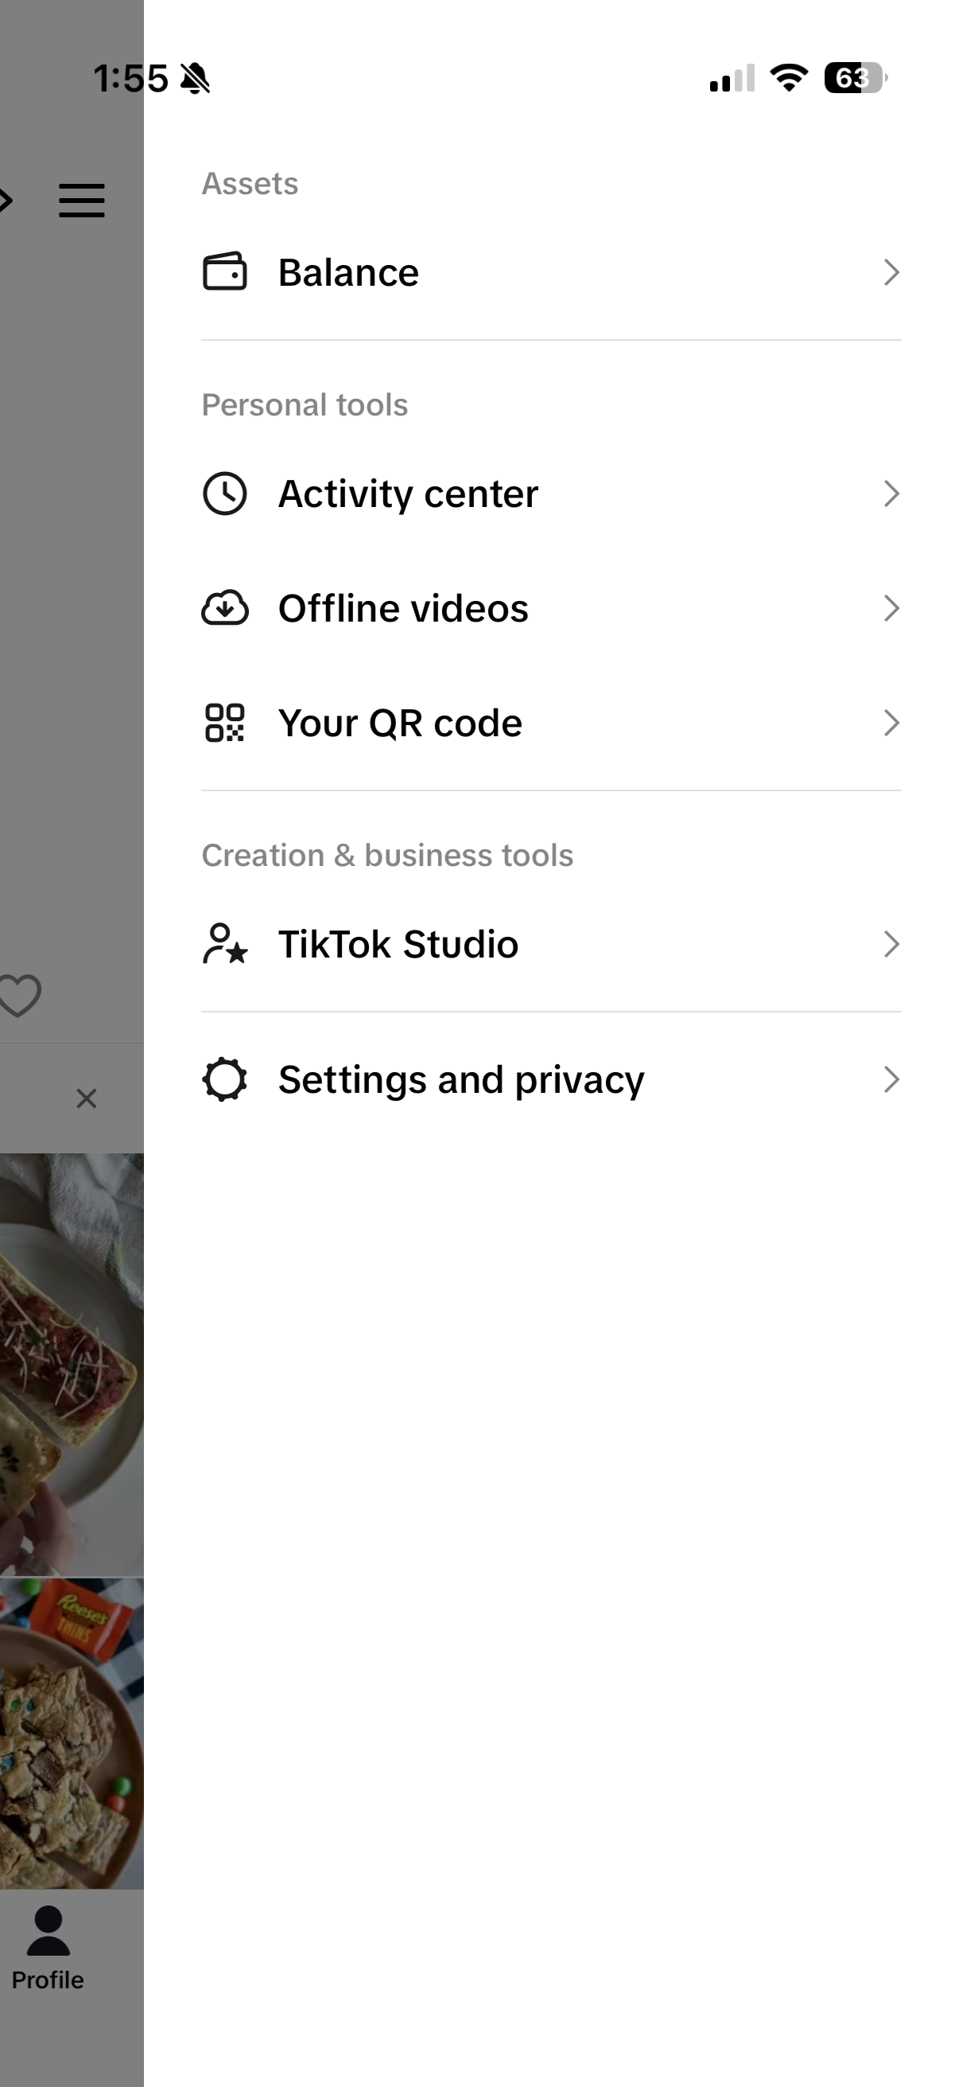
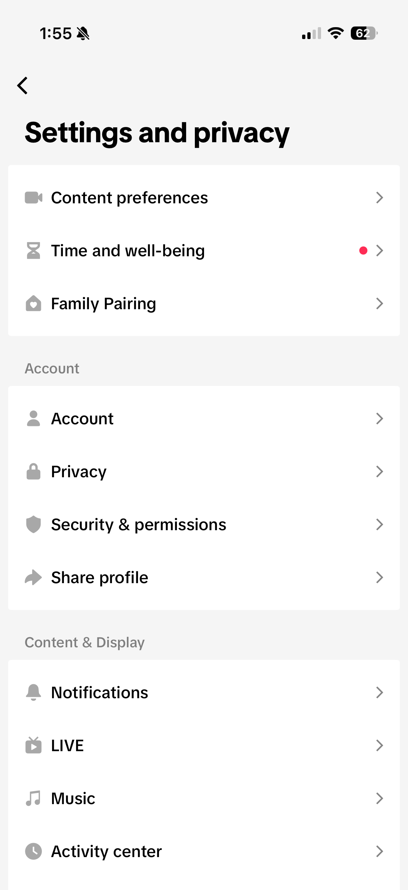

Switch to a Business Account
How to Change Your Account Type
In the TikTok app, tap Profile at the bottom.
Tap the Menu ☰ button at the top, then select Settings and privacy.
Tap Account.
Tap Switch to Business Account, then follow the steps to switch your account type.
Select your category as Health and Wellness or Creator.
Tap Next and complete the setup
Notes:
Why Business Account?
Unlocks TikTok Analytics so you can track what content is working
Gives you access to Creator Tools and TikTok Shop for Creator
Keeps your professional content separate from personal use
Required to access TikTok Shop affiliate features
Select Health and Wellness as your category -- this helps TikTok understand your niche from day one.

Slide 7
1
Profile Photo
Clear, well-lit photo of your face. Natural light, warm smile. Your photo should match how you look on camera.
Bio
Answer: who are you, what do you share, and why should someone follow you? No income claims or health results in your bio.
Link
Point to your Amare TikTok Shop Product Showcase once set up.
Optimize Your Profile
2
3
Notes:
Profile Photo
Use a clear, well-lit photo of your actual face. Not a logo, not a graphic, not a pet.
Natural light works great. Smile. Look approachable. People buy from people they feel like they know.
Consistent with how you show up on camera so new viewers recognize you immediately.
Bio
Keep it to one or two sentences. You have 80 characters.
Answer: who are you, what do you share, and why should someone follow you?
Good example: 'Sharing the wellness products I actually use. Shop my Amare favorites below.'
Include a soft call-to-action pointing to your product showcase link.

Slide 8
Applying to Become an Affiliate Creator on TikTok Shop

Slide 9
Affiliate Creator Eligibility Requirements
Must be at least 18 years old
Must be based in the United States
Must have a minimum of 1,000 followers on TikTok
Must not have had e-commerce permissions previously revoked
Must pass TikTok's identity verification process (covered in Part 5)
If You Are Under 1,000 Followers
You cannot apply for Affiliate Creator status yet. Focus on building your audience first.
Notes:
Eligibility Requirements
Must be at least 18 years old
Must be based in the United States
Must have a minimum of 1,000 followers on TikTok
Must not have had e-commerce permissions previously revoked
Must pass TikTok's identity verification process (covered in Part 5)
If You Are Under 1,000 Followers
You cannot apply for Affiliate Creator status yet. Focus on building your audience first.
Post consistently, engage with your niche, and come back to this step once you hit 1,000 followers.
You can still watch and prepare all other videos while you build your following.

Slide 10
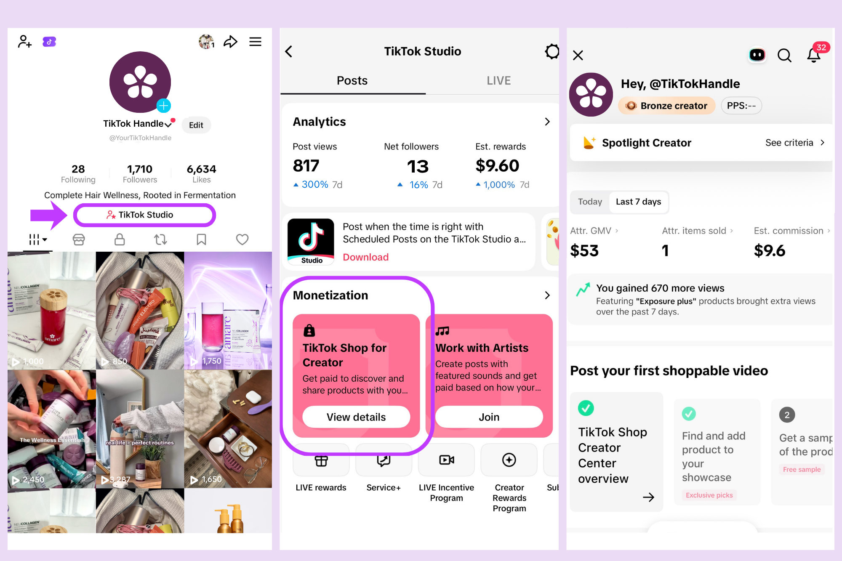
Apply to become an Affiliate Creator
How to Change Your Account Type
In the TikTok app, tap Profile at the bottom.
Tap “TikTok Studio”
Note: You can also tap the Menu ☰ button at the top, then select TikTok Studio.
Tap TikTok Shop for Creator found under the Monetization section of the page.
If you meet the requirements you will see a button that says Apply in red, tap it. If the button is grayed out you may not yet have met the 1k follower requirement.
Approval typically takes a few minutes, but can take longer. Check your status: TikTok app > Inbox > System notifications.

Slide 11
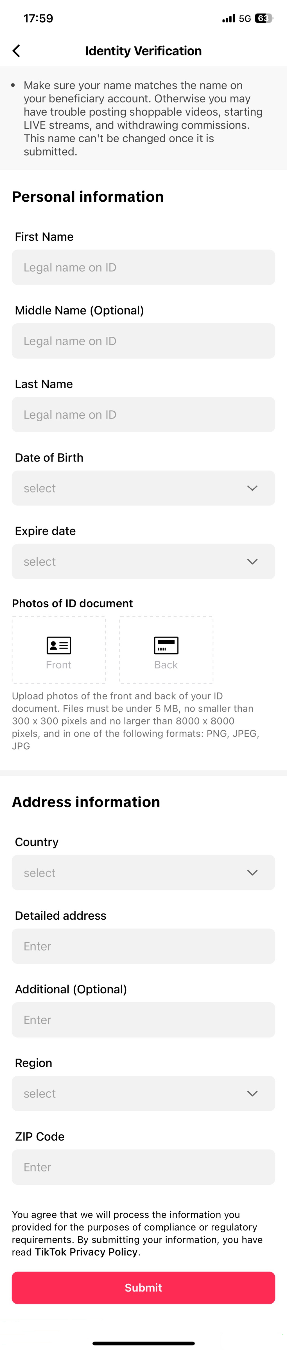
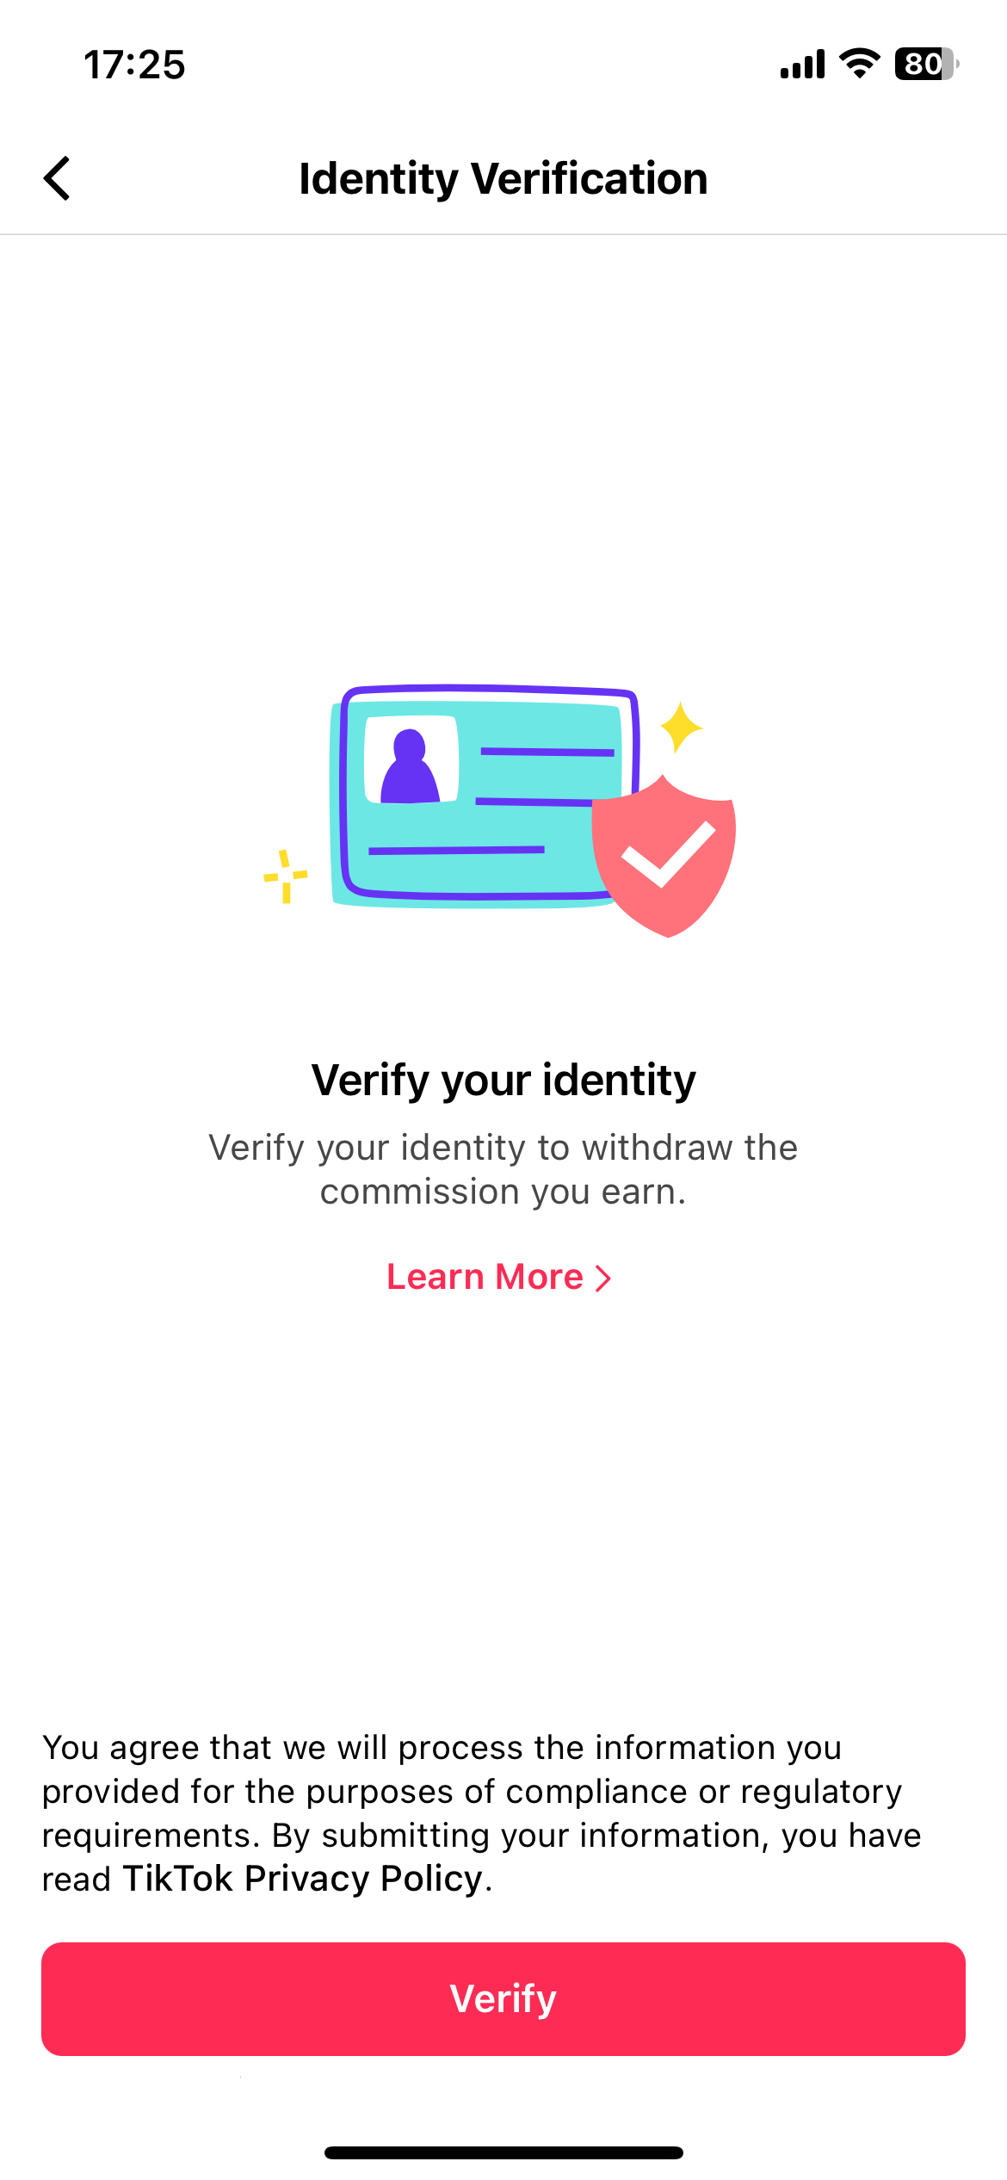
Verify Your Identity
In the TikTok app, tap Profile at the bottom.
Tap the Menu ☰ button at the top, then select TikTok Studio.
Tap TikTok Shop for Creator and navigate to the Earnings page.
Look for the prompt that says 'Verify your identity to cash out' and tap Add. Alternatively, the prompt may appear as a pop-up when you attempt to withdraw.
Fill out all required fields and upload a clear, color photos of the front and back of your government-issued ID and tap Submit.
Verification can take up to 24 hours. Check your status at: TikTok Studio > Notification Center (top right)
Notes:
If Verification Fails
You can retry up to 10 times if the failure is due to image quality or a technical issue. Make sure photos are clear, in color, and not cropped.
If you cannot verify after multiple attempts, you can appeal by submitting a selfie holding your ID. Up to 2 appeal attempts are allowed.
One government-issued ID can be used to verify up to 5 creator accounts.
Without completed identity verification, you cannot withdraw earnings from TikTok Shop.

Slide 12
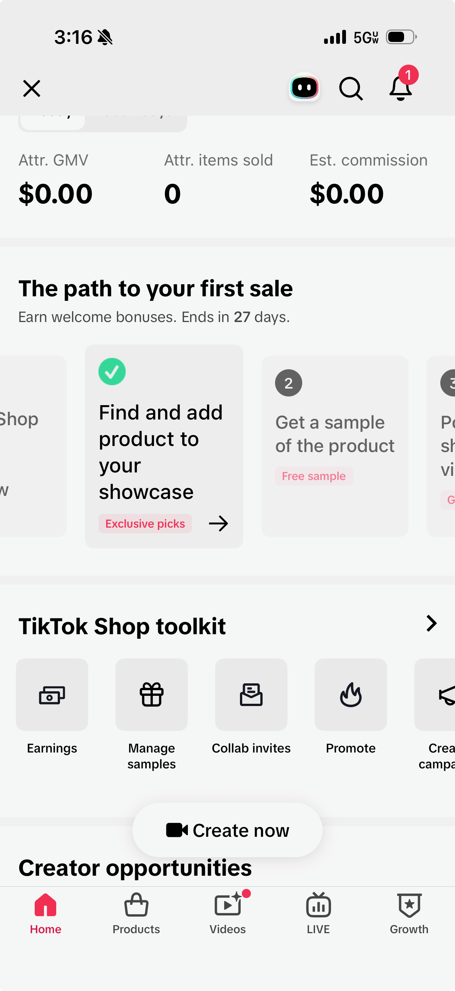
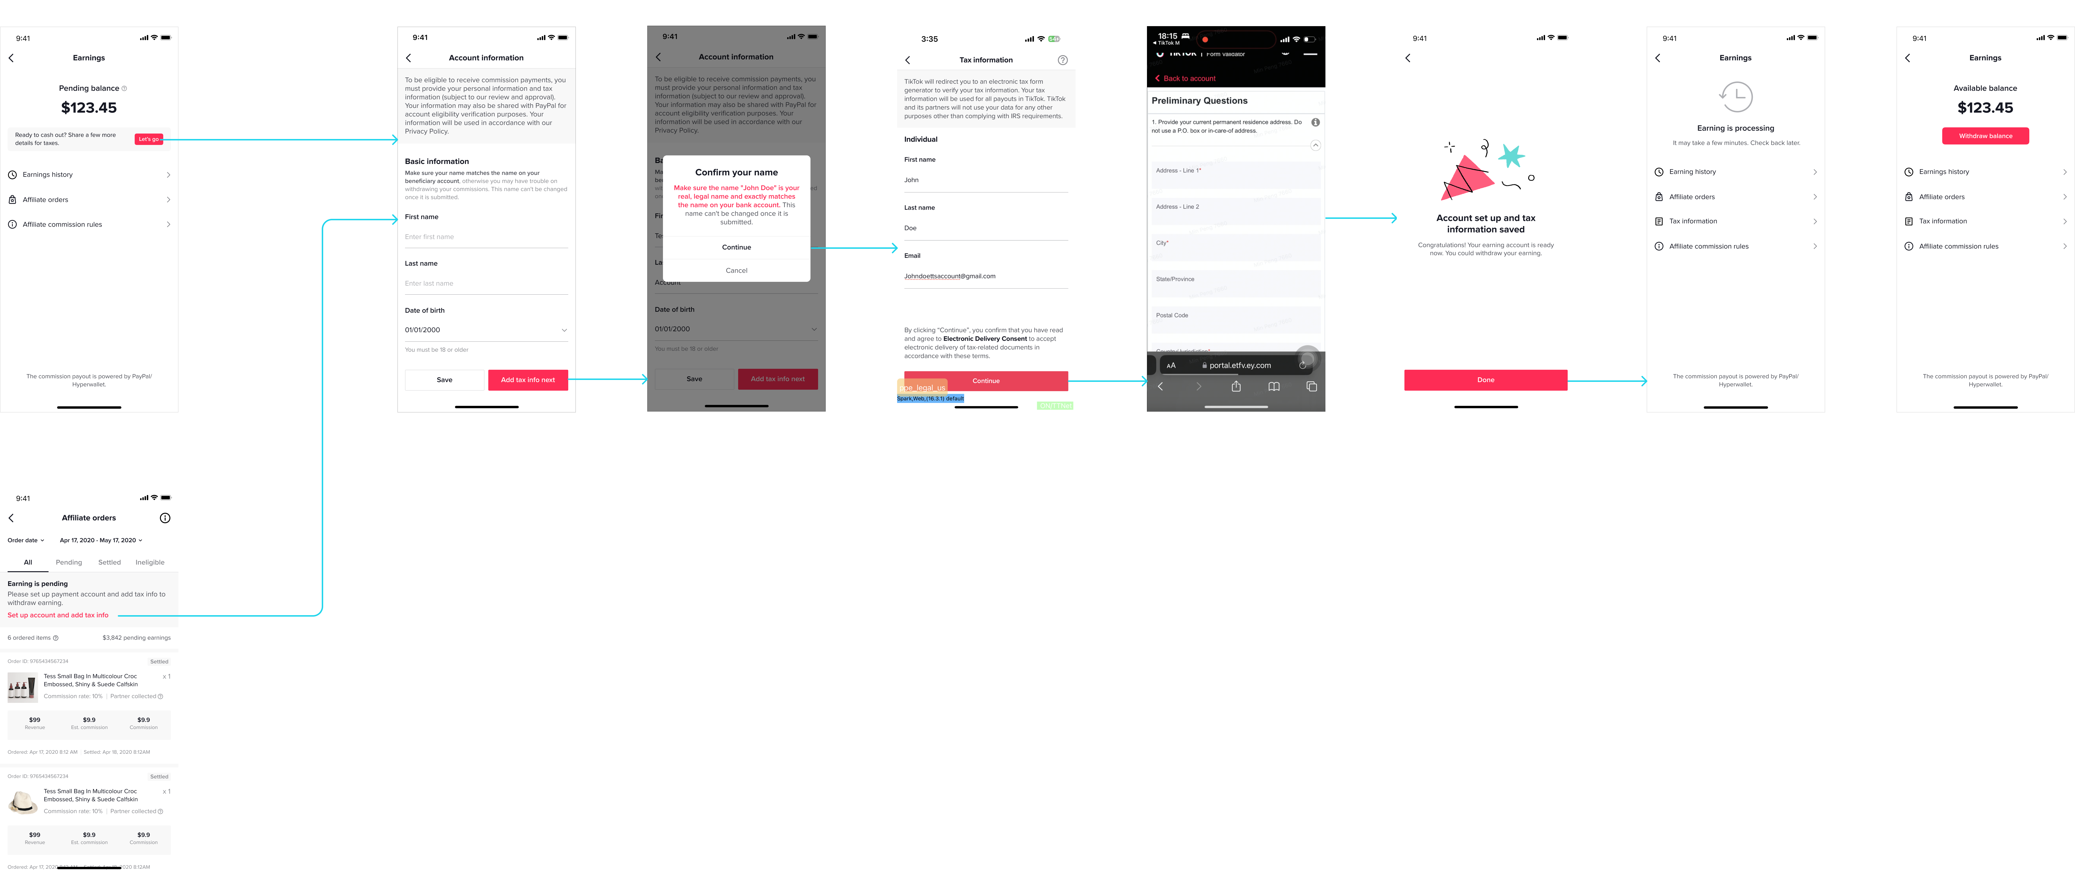
Set Up TikTok Commissions
Step-by-Step: Set Up TikTok Commissions
In the TikTok app, tap Profile at the bottom.
Tap the Menu ☰ button at the top, then select TikTok Studio.
Tap TikTok Shop for Creator and navigate to the Earnings button page.
If you have not entered your payout method or tax information, there will be a banner notification directing you to do so.
Enter your personal tax information (SSN or EIN required for U.S. payouts) and your bank account or payment details.
Submit and confirm
Notes:
Do This Before Your First Sale
Setting up your commission account after you have already generated sales can delay your payouts.
TikTok requires this step to be completed before funds can be released.

Slide 13
Understanding the TikTok Affiliate Creator Pilot Program

Slide 14
TikTok Affiliate Creator Pilot Program
Pilot Program Limits
Maximum 5 shoppable videos per week Maximum 3 shoppable LIVE sessions per week
How to Graduate from the Pilot Program
Reach 5,000 followers. Complete the graduation requirements
Graduation Requirements
Within a 30-day period, you must complete ONE of the following: publish 6 or more shoppable videos that are each at least 8 seconds long; complete at least one qualifying LIVE session of at least 5 minutes; or generate 10 orders through your content. You must also maintain a Creator Health Rating above 176 points and pass TikTok’s education quiz.

Slide 15
What is a Creator Health Rating?
Creator Health Rating (CHR)
TikTok Creator Health Rating is a performance and compliance score that shows how well your content aligns with platform guidelines. It directly influences your reach, discoverability, and eligibility for monetization features.
How to Maintain a high Creator Health Rating
Do not make health claims, income claims, or use recruitment language. If you get a violation, take the quiz immediately. Post compliant content consistently. Check your Creator Health Rating regularly.
How to Find Your Creator Heath Rating
On the TikTok app, open TikTok Studio > TikTok Shop for Creator, then scroll to the bottom of the page to find your Creator Health Rating. Your Creator Health Rating is only visible to you.
Notes:
Do not make health claims, income claims, or use recruitment language. These are the violations most likely to hit Amare brand partners and the ones that will cost points fastest.
If you get a violation, take the quiz immediately. A perfect score on the related policy quiz earns 5 points back. Don't ignore violation notifications.
Post compliant content consistently. Every piece of content that follows policy and generates an order earns you a point back. Consistent posting is the slow-burn way to keep your score healthy.
Check your CHR weekly. The Personalized Account Health Report shows your overall total points gained or lost over the past week, with a breakdown of both points deducted and earned. You can access it from the top-right corner of your CHR page.

Slide 16
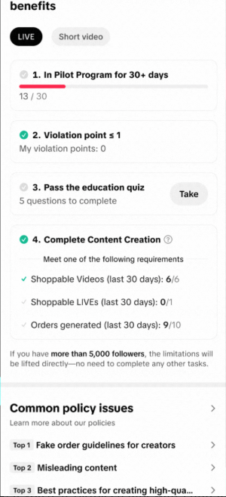
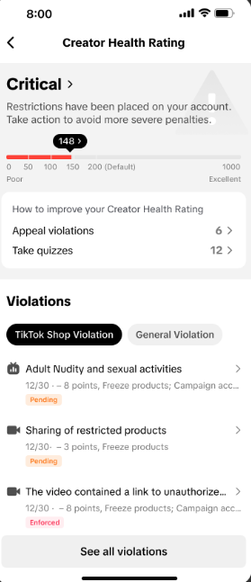
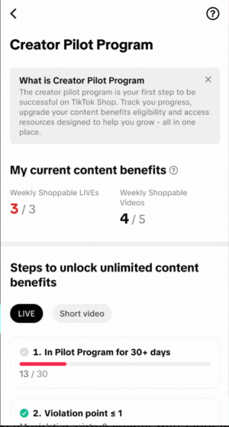
Creator Pilot Program Check In
Creator Health Rating
Education Quiz
Notes:
On the TikTok app, open Creator Center > TikTok Shop for Creator, then scroll to the bottom of the page to find your Creator Health Rating. Your Creator Health Rating is only visible to you.
From the TikTok Shop for Creator section you can also see your status in the creator pilot program

Slide 17
Joining Amare’s TikTok Shop

Slide 18
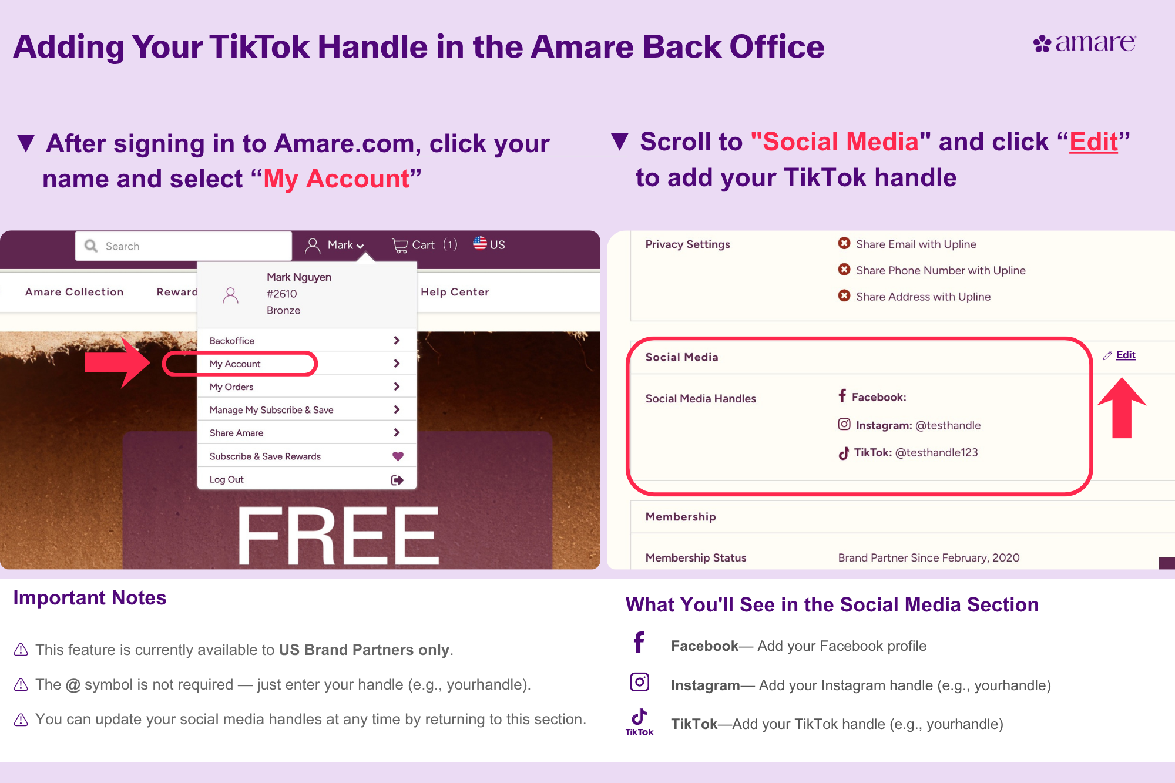

Slide 19
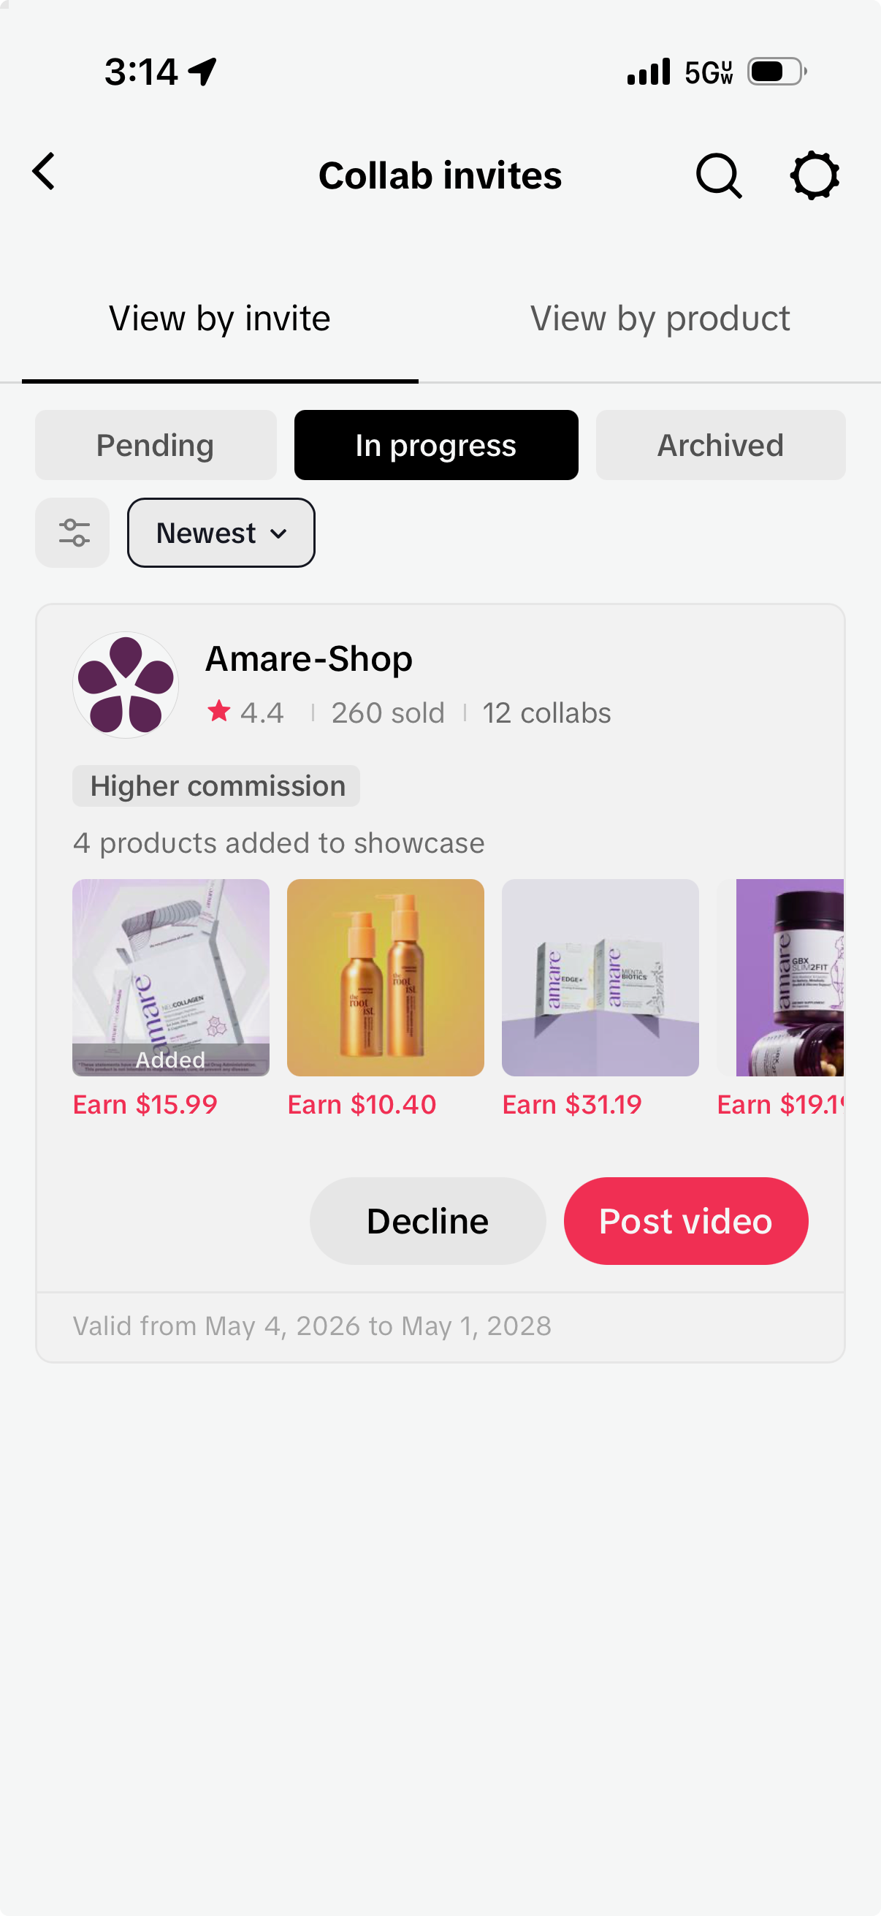
Get Invited to Share Amare's TikTok Shop
After entering your TikTok handle in Amare’s back office, accept the Terms & Conditions and watch the compliance video
You will receive an invite to join the Amare TikTok Shop. Please allow 2-3 days to receive the invitation.
In the TikTok app, tap Profile at the bottom. Tap the Menu ☰ button at the top, then select TikTok Studio.
Tap TikTok Shop for Creator and tap Collab Invites to search for Amare.
Once approved, you'll see the Amare products available to promote on TikTok Shop.

Slide 20
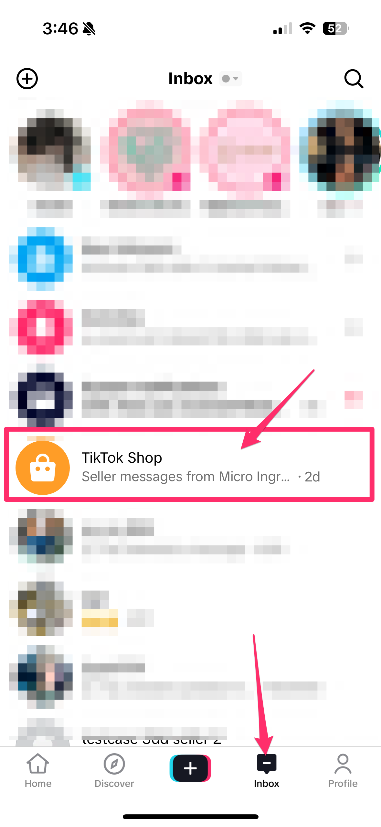
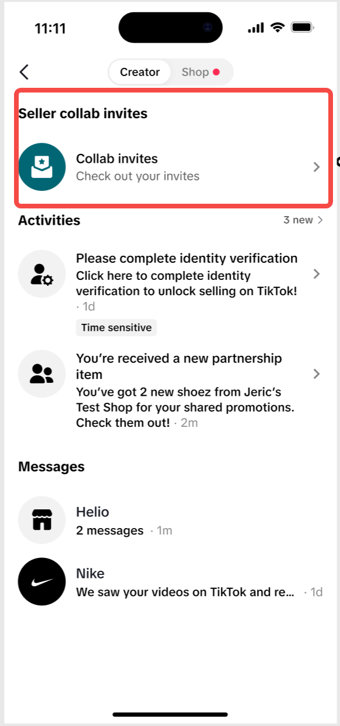
Locating Your Collab Invite with Amare
In Your TikTok Inbox
In TikTok Studio

Slide 21
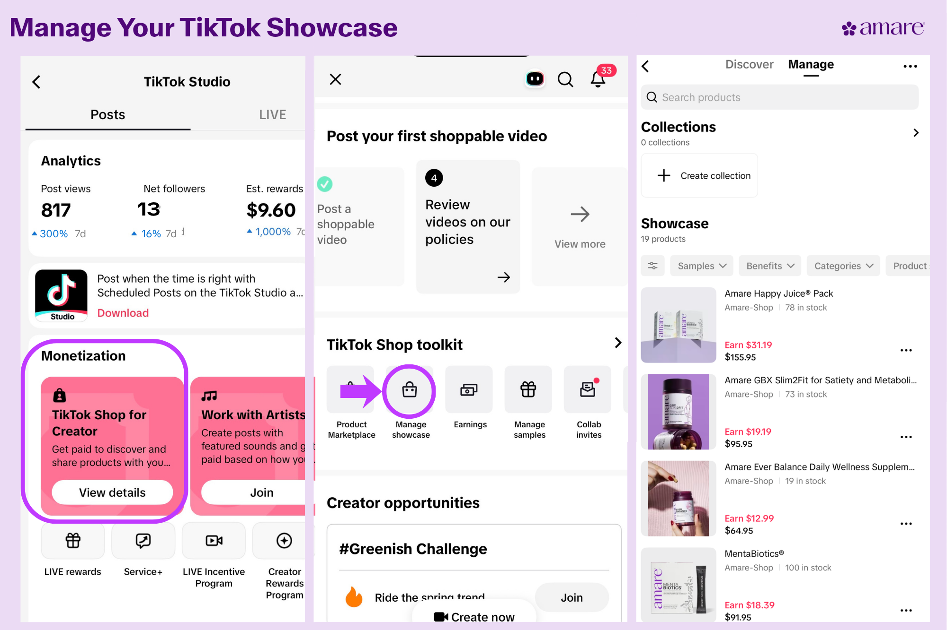
Add Amare Products to Your TikTok Showcase
In the TikTok app, tap Profile at the bottom.
Tap the Menu ☰ button at the top, then select TikTok Studio.
Tap TikTok Shop for Creator and navigate to the TikTok Shop Toolkit page.
Tap Manage Showcase then Add Products.
Search for and add Amare products to your showcase.
Notes:
Showcase is your personal storefront on TikTok, a dedicated tab on your TikTok Profile Page where you can display and sell the products you love and recommend to your community..

Slide 22
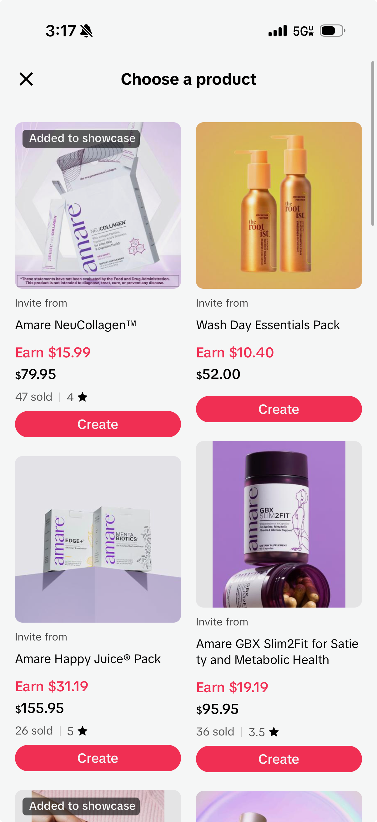
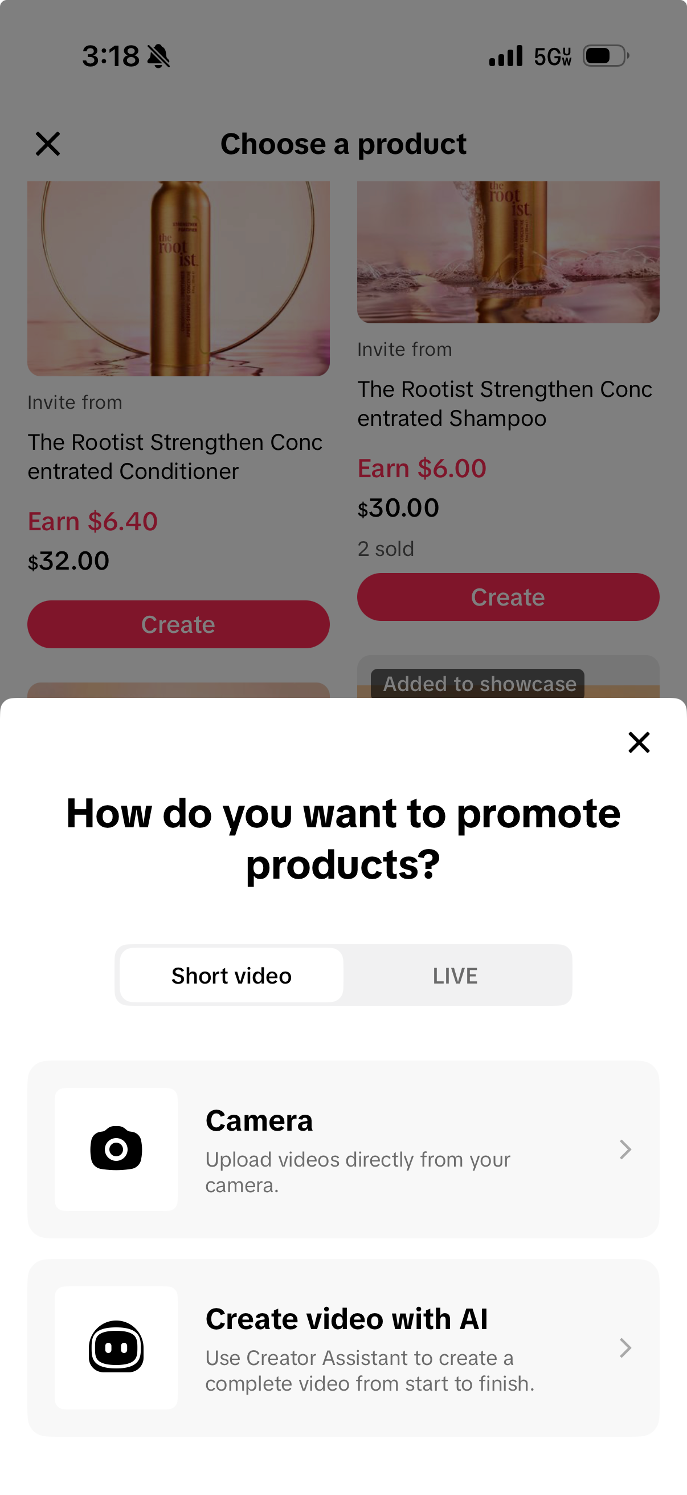
Start Sharing!
What to do Next:
Post your first video with your favorite Amare products!
Try going live at least once, even just for 5 minutes!
Keep an eye on your Creator Health Rating
Keep an eye out for more training videos
Notes:
Okay, your account is set up. Your affiliate access is in motion. Here's what to do next.
Start posting. Don't wait until it's perfect — your first video is just practice, and that's okay. Add an Amare product link, hit publish, and see what happens. That's literally all it takes to get the ball rolling.
This week, try to go LIVE at least once. Even five minutes counts toward your Pilot Program graduation — and the more you do it, the less scary it gets.
Check your Pilot Program status and Creator Health Rating every Monday. You're aiming for six shoppable videos, one qualifying LIVE, or ten orders to graduate. Most people get there faster than they expect.
Graduation isn't a mountain — it's just 30 days of showing up.
And you're not doing this alone. More videos are coming — content strategy, how to structure a great video, growing your audience, live selling, and how to use AI tools to make all of this way faster. They'll be waiting for you when you're ready.
The hard part is done. Now just go be you on camera.

